Slide 1
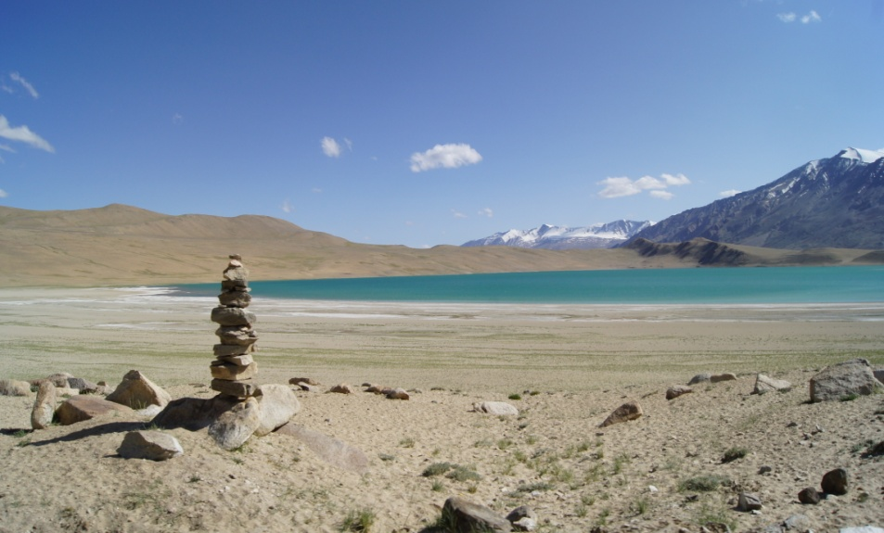
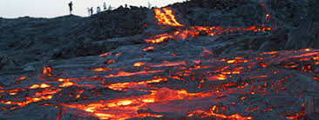
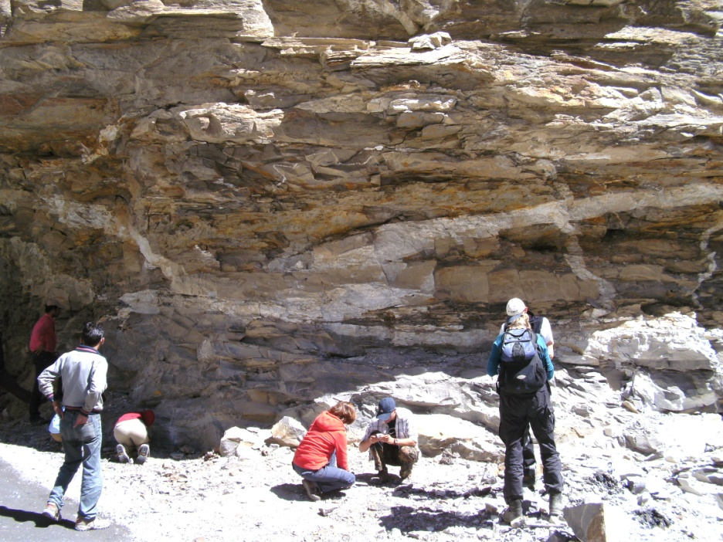
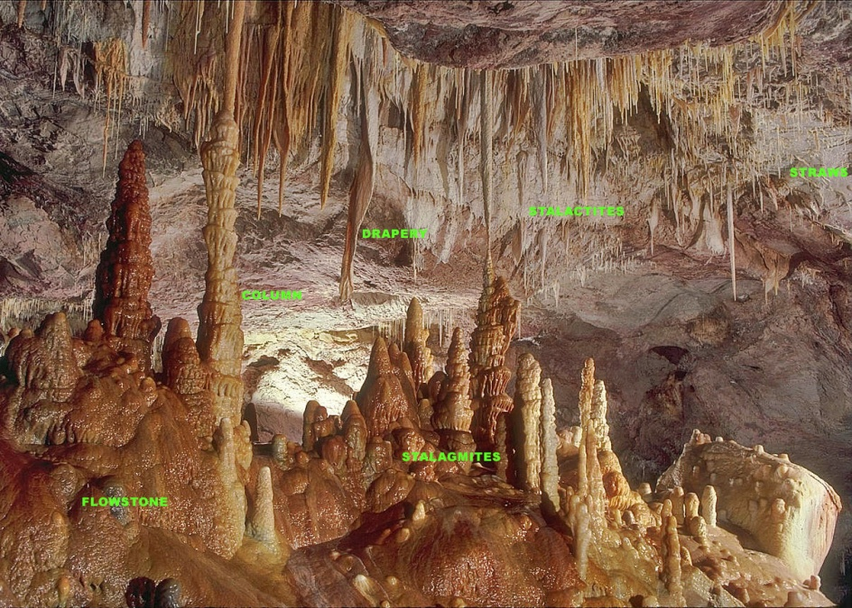
IDC203: IDC:203: Introduction to Earth Sciences

Slide 2
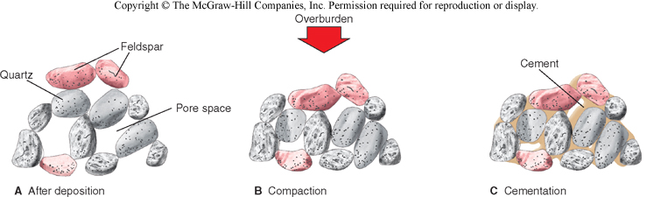
Lithification

Slide 3
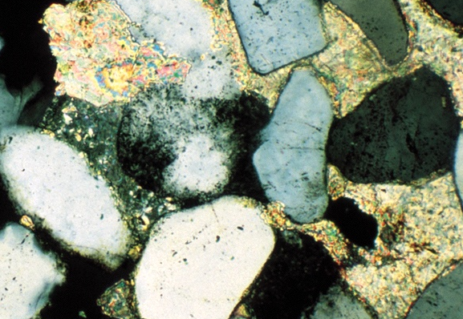
Calcite
cement
Quartz grain
Fig. 7.13
Peter Kresan

Slide 4
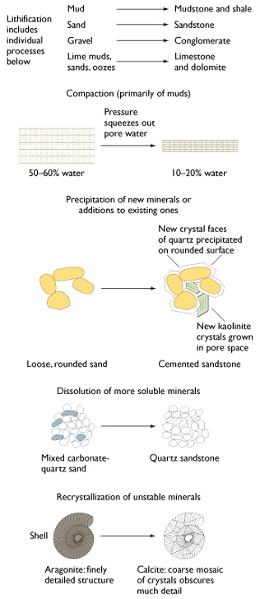
Products of lithification

Slide 5
From sediment to sedimentary rock (lithification)
Compaction: reduces pore space
Clays and muds are up to 60% water; 10% water after compaction.
Cementation: chemical precipitation of mineral material between grains (SiO₂, CaCO₃, Fe₂O₃) binds sediment into hard rock.
Recrystallization: P and T increase with burial 30°C/km or 1°C/33 m.

Slide 6
Compaction (Primarily of Muds)
Precipitation
of new minerals or additions to existing ones
Fig. 7.12

Slide 7
Dissolution of More Soluble Minerals
Recrystallization of Unstable Minerals

Slide 8
Clues to interpreting sedimentary environment
• Sedimentary structures
• Sorting, roundness, sphericity
• Sequence of beds

Slide 9
Environment of deposition
Modern Analogue
Key to interpreting transport history of sediments and rocks
Model
Based on idea that a “particular set of environmental conditions operating at a particular intensity will produce a sedimentary deposit with a unique set of properties that will identify if as the product of a particular environment”
(Boggs, 2001)

Slide 10
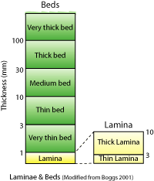
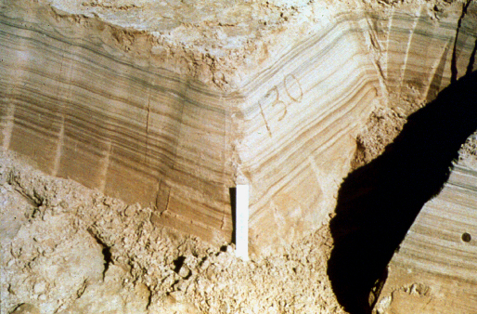
Sedimentary Structures
Bedding
Series of visible layers within a rock
Most common sedimentary structure

Slide 11
Sedimentary structures
Stratification = bedding = layering
Produced due to differences in
1. size of particles
2. kinds of particles

Slide 12
Sedimentary structures
Particular structural features can give information about the environment of deposition.
Structures also help determine if a bed is right-side-up.
— this is important in deformed rocks

Slide 13
Environment of deposition
Modern Analogue
Key to interpreting transport history of sediments and rocks
Model
Based on idea that a “particular set of environmental conditions operating at a particular intensity will produce a sedimentary deposit with a unique set of properties that will identify if as the product of a particular environment”
(Boggs, 2001)

Slide 14
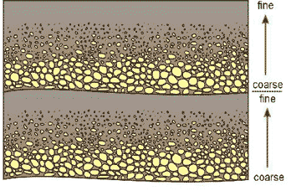
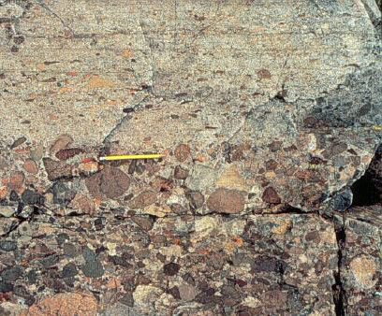
Graded bedding
Scale may be mm to m

Slide 15
Fossils
Traces of plants or animals preserved in rock
Hard parts (shells, bones) more easily preserved as fossils

Slide 16
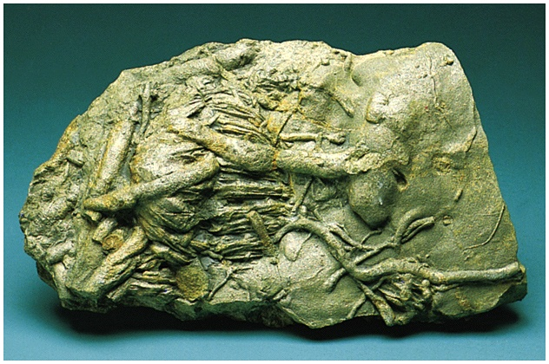
Bioturbation tracks and tunnels

Slide 17
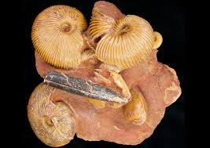
Fossils

Slide 18
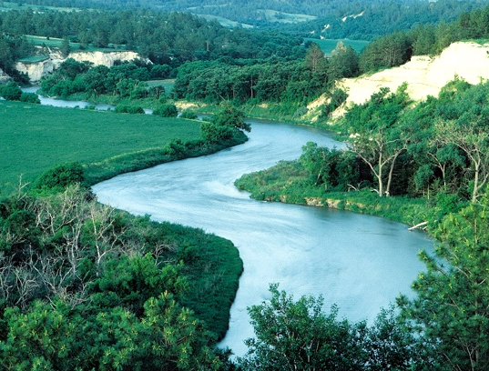
Streams: transport to the ocean

Slide 19
Rivers and streams
Stream : body of water flowing in a channel
The floor of the channel is called the bed.
When rainfall is very heavy or snow melts rapidly, bodies of water overflow their banks and water covers the adjacent land called the floodplain.

Slide 20
Rivers and streams
Carry away runoff to lakes and seas
Erode land (degradation)
Transport and deposit sedimentary debris

Slide 21
Stream behavior
Mostly determined by velocity and shape of channel.
These factors combine to allow either laminar or turbulent flow.
Turbulent flow is much more erosive.
Stream velocities may vary from 0.25 to 7 m/s.

Slide 22
Laminar flow
Smooth sheet-like flow at a low velocity
Usually confined to edges and top of stream

Slide 23
Turbulent flow
Irregular swirling flow
Occurs at most rates of stream flow
Keeps particles in suspension

Slide 24
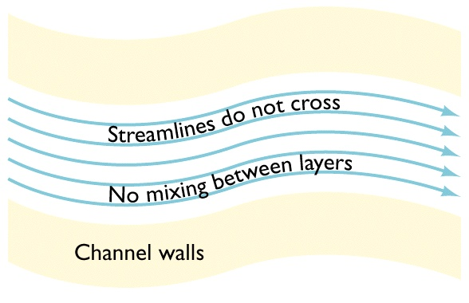
Laminar flow

Slide 25
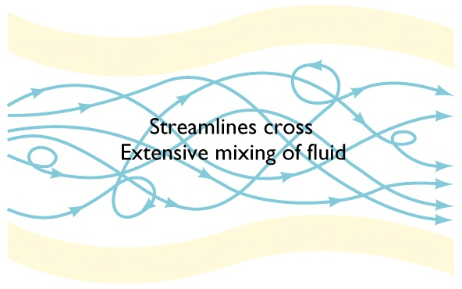
Turbulent flow

Slide 26
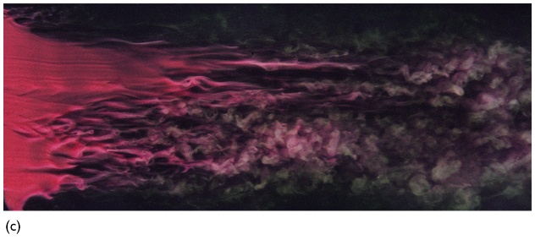
Laminar to turbulent transition
Laminar flow
Turbulent flow
ONERA
Fig. 13.1c

Slide 27
Streams move material in three forms
Dissolved load
Suspended load
Bed load (traction and saltation)

Slide 28
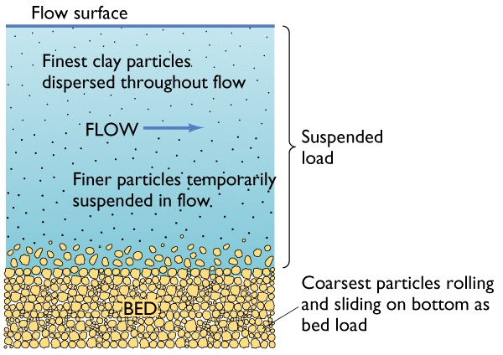
Sediment Transport

Slide 29
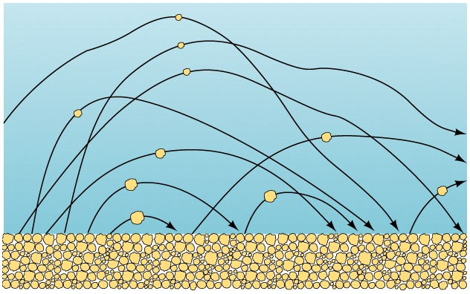
Saltation

Slide 30
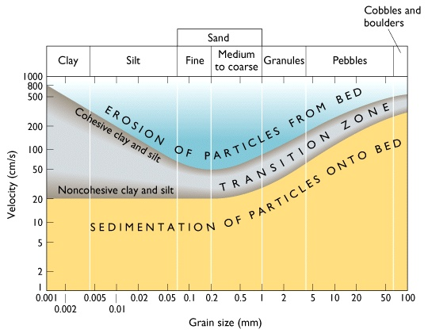
Grain size and flow velocity

Slide 31
Stream terms
competence: measure of the largest particles a stream can transport proportional to v²
capacity: maximum quantity of sediment carried by stream proportional to Q and v

Slide 32
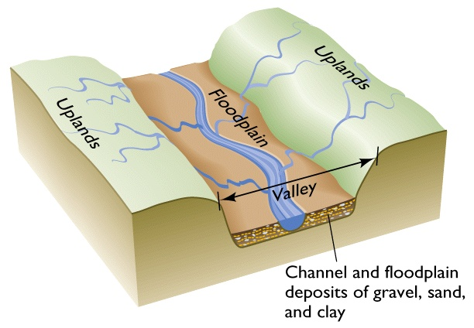
Parts of a River System

Slide 33
Two important stream types
1. Meandering Streams
A meander, in general, is a bend in a sinuous watercourse or river.
A meander forms when moving water in a stream erodes the outer banks and widens its valley, and the inner part of the river has less energy and deposits silt

Slide 34
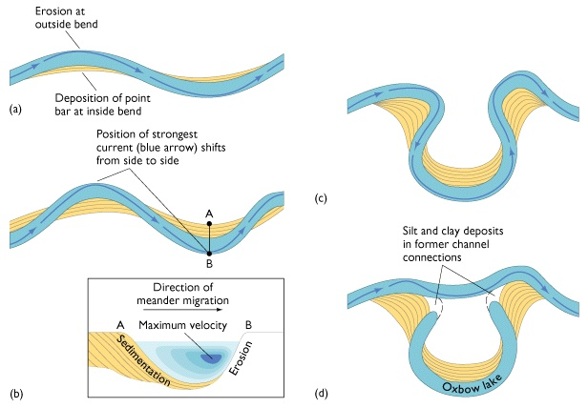
Meandering River Over Time

Slide 35
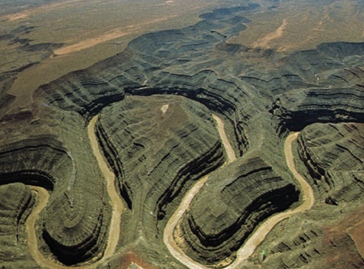
Incised Meanders, Utah
Tom Bean

Slide 36
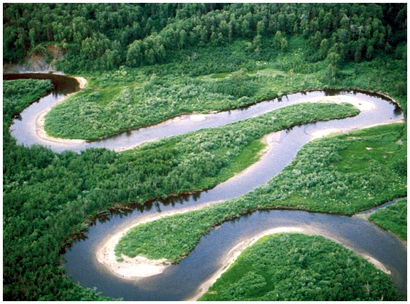
Meandering River
Point Bar

Slide 37
Two important stream types
2. Braided Streams
Sediment supply greater than amount stream can support.
At any one moment the active channels may account for only a small proportion of the area of the channel system, but essentially all is used over one season.
Common in glacial, deserts, and mountain regions.

Slide 38
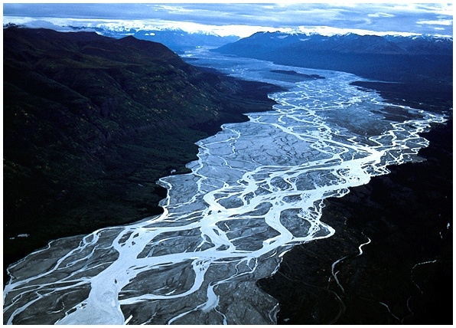
Braided River

Slide 39
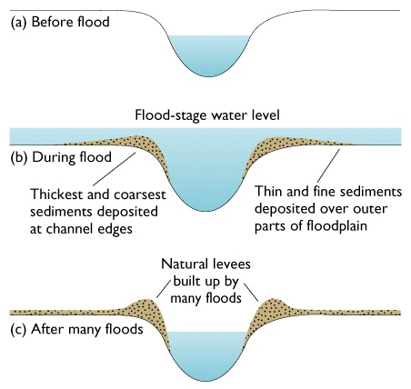
Formation of Natural Levees

Slide 40
Flooding
Water in the stream is greater than the volume of the channel.
Interval between floods depends on the climate of the region and the size of the channel

Slide 41
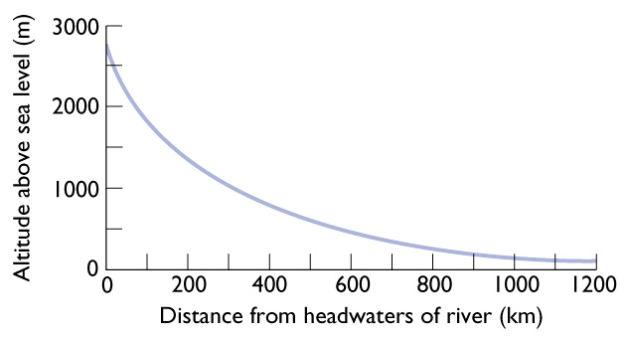
Longitudinal Stream Profile of the Platt and South Platt Rivers

Slide 42
Graded stream
Stream in which neither erosion nor deposition is occurring, due to an equilibrium of slope, velocity, and discharge.

Slide 43
Geologic evidence of changes in stream equilibrium
Alluvial fans
Terraces: erosional remnants of former floodplains

Slide 44
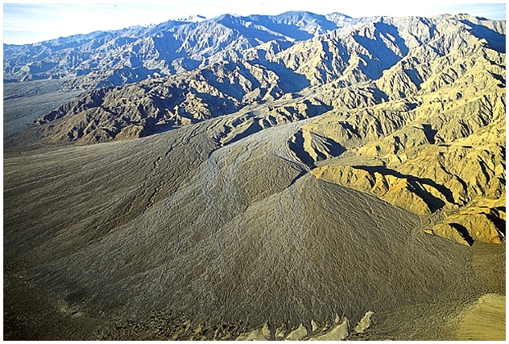
Alluvial fans
Alluvial Fans

Slide 45
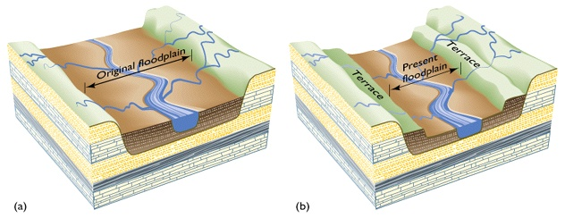
Formation of River Terraces

Slide 46
Life History of a Stream
Youthful Stream
Steep gradients
V-shaped cross sections
Rough sediments flowing rapidly down stream.
Due to greater water velocity larger sediment can be moved.

Slide 47
Life History of a Stream
Sediments cut through bedrock as they are moved along
Common to find rapids and waterfalls due to differences in resistance of the bedrock to weathering.

Slide 48
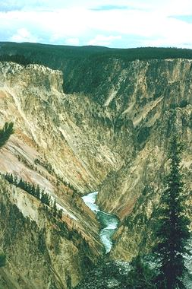

Slide 49
Mature Streams
Potential energy for cutting and removing rock becomes less.
The average gradient is decreased.
Velocity near the bed becomes less.
The size of sediment that can be moved decreases.
Bed becomes covered with loose material, thus protecting it from further erosion.

Slide 50
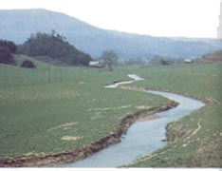

Slide 51
Old Streams
Gradient becomes extremely small and only the finest of sediments can be moved.
During times of peak flow the banks will overflow and flood the nearby portions of its valley.
When the flow subsides a layer of silt and clay is left behind on the valley surface, this is the flood plain.

Slide 52
Water Velocity in a meander
Water velocity is greatest along the outside curve of a meander. Here erosion is dominant.
Water velocity is slowest along the inside of a meander. Here deposition is dominant.

Slide 53
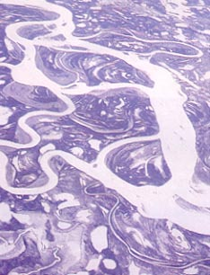

Slide 54
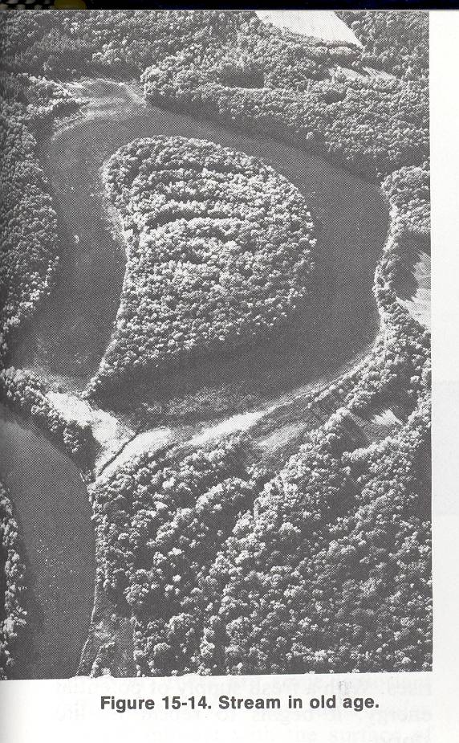
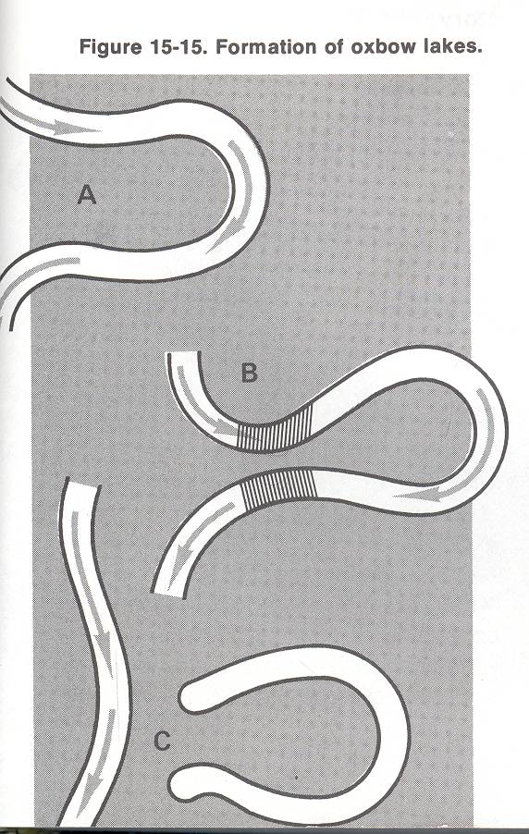

Slide 55
Outside of meander
Inside of meander: deposition is dominant
Inside of meander
Inside of meander
Outside of meander
Erosion dominant
Outside of meander

Slide 56
Locations of Stages
It is unlikely that any stream is at the same stage of development throughout it entire length.
Most streams tend to have the characteristics of youth near their source and of old age near their mouths and to be in the mature stage somewhere in-between..

Slide 57
Wind Erosion
Wind erodes dry land much more effectively than it does moist land.
As the wind erodes land it carries rock particles along with it, mostly sand, silt, and clay.
Sand material is moved along by a number of jumps and bounces, much how a pebble is moved along the bottom of a stream bed.

Slide 58
Wind Erosion
The grains do not rise higher than about 1meter, and they move in the same direction the wind is blowing.
Dust particles (silt and clay) can be carried along great distances and at greater heights than sand particles

Slide 59
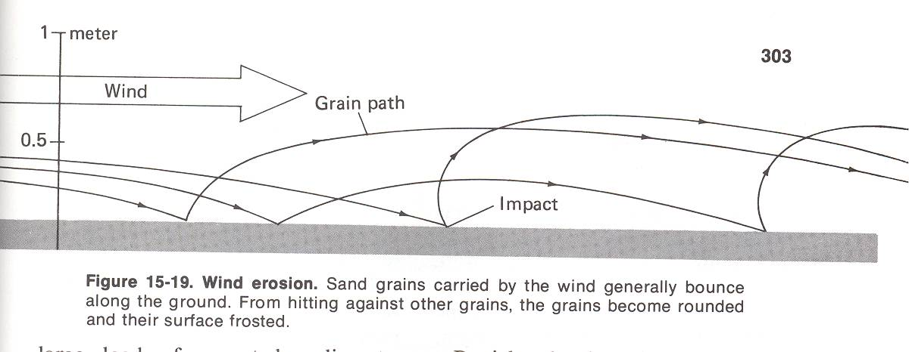

Slide 60
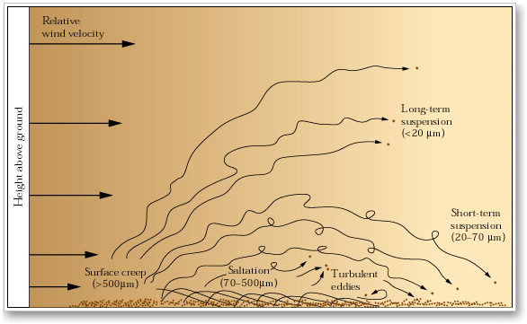
Wind Transport
Moderate winds move the largest sand grains by surface creep. Slightly smaller sand grains move forward by saltation (bouncing). Finer particles are carried aloft where faster wind transports them downwind before they slowly settle to the ground. The very finest dust particles reach greater heights and are swept along in suspension as long as the wind keeps blowing.

Slide 61
Effects of wind erosion
Abrasion : weathering of rock particles by the impact of other rock particles.
In areas where there are strong, steady winds, large amounts of loose sand, and relatively soft rocks, abrasion causes a great amount of erosion.

Slide 62
Effects of wind erosion
Pebbles and small stones exposed to wind abrasion show surfaces that are flattened and polished on two or three sides.
Rocks smoothed this way are called ventifacts.

Slide 63
Erosional Landforms

Slide 64
Ventifact
Created by wind erosion
Wind carries fine particles that work like a sand blaster (i.e. sand, silt, clay, and ice particles)
The windward face of the rock is flattened and smoothed
Usually pebble to cobble sized

Slide 65
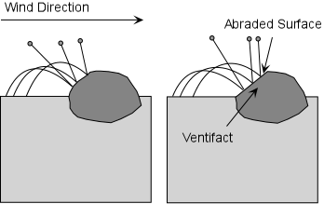

Slide 66
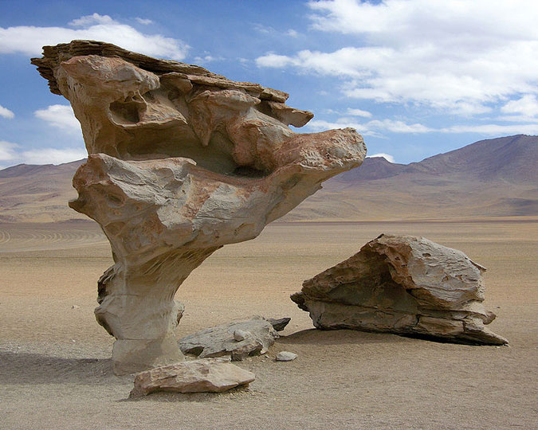
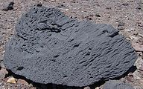
Ventifact

Slide 67
Dreikanter
A type of ventifact that has three ridges
Multiple faces have been formed by either a changing prevailing wind or movement of the actual rock being weathered

Slide 68
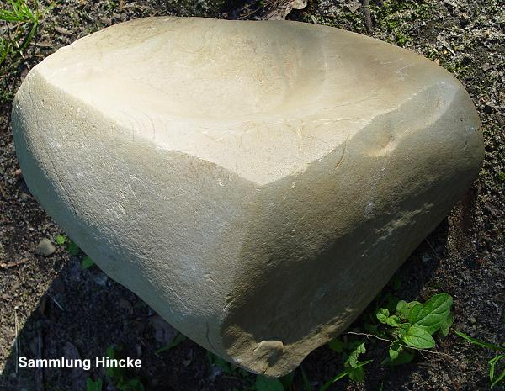

Slide 69
Desert pavement
Formed in arid environments when wind carries finer, more lightweight particles such as sand away
Large particles are left behind and protect from further erosion

Slide 70
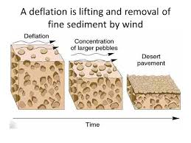
Deflation
Low spots carved out by wind erosion
High elevations are left due to vegetative stabilization

Slide 71
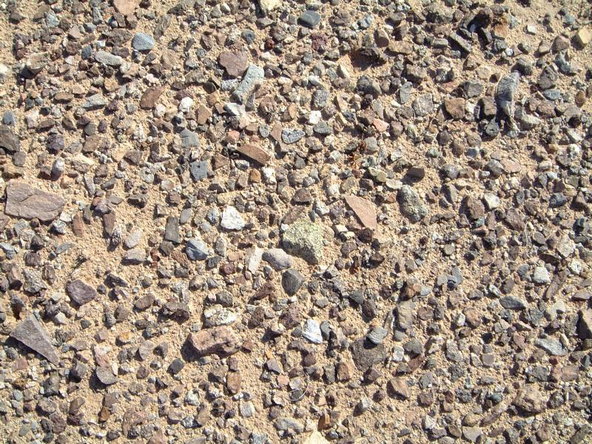

Slide 72
Pedestal rock
Base of a rock is weathered and eroded more quickly due to sand blasting
Sand grains can only be picked up a couple of feet

Slide 73
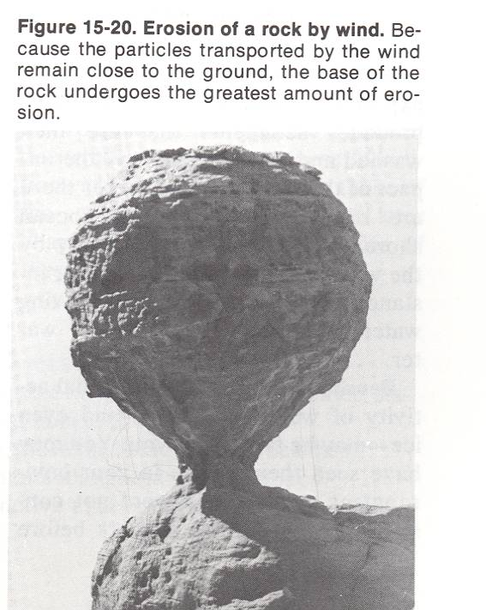

Slide 74
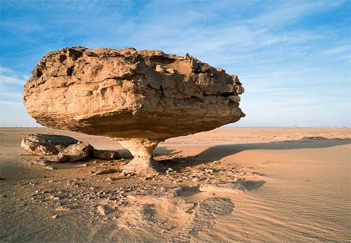

Slide 75
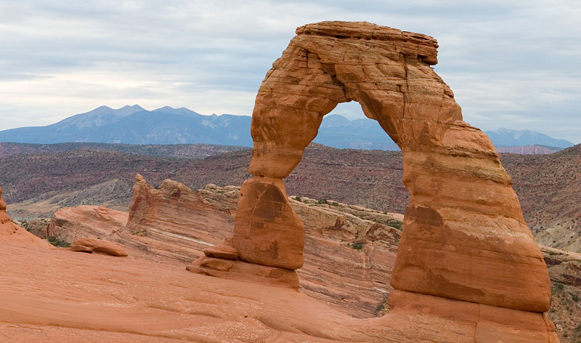
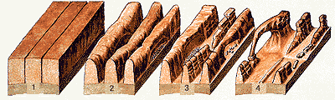
Desert Arch
Typically formed by wind
Narrow ridges are formed and the softer substrata is weathered first, forming a bridge/arch overhead

Slide 76
Depositional Landforms

Slide 77
Loess
Yellowish, fine grained silt and clay sized particles
Carried and deposited by wind

Slide 78
Loess
Criteria for Loess formation:
- dust source (Periglacial and non-glacial deposits)
adequate wind energy to transport the dust,
a suitable accumulation area
sufficient amount of time

Slide 79
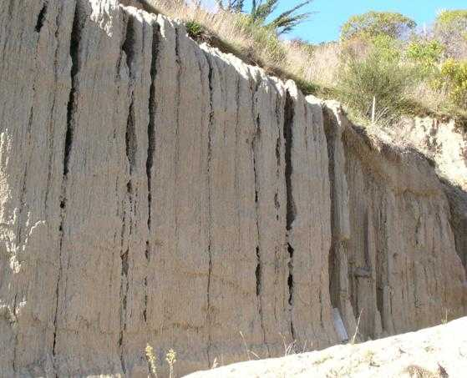
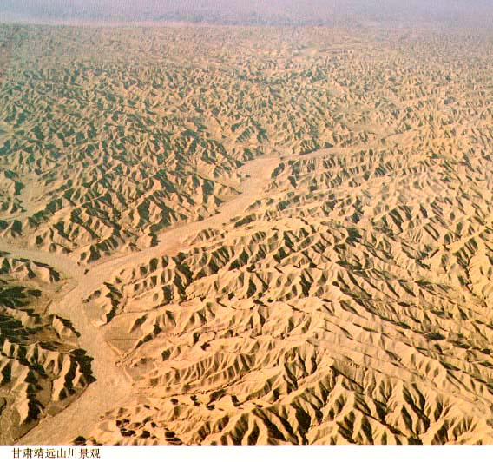
Loess

Slide 80
Sand Dunes
Piles of sand
Deposited by wind
Leeward side (slipface) has a steeper slope
Windward side is more gradual

Slide 81
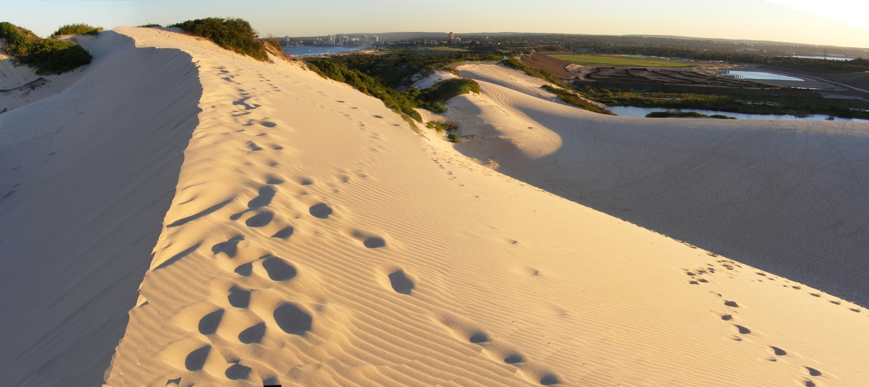
leeward
windward
leeward

Slide 82
Deposition and Dune Types
Dune Types
- Transverse- ridges that are perpendicular to prevailing wind direction
- Longitudinal- ridges that are parallel to prevailing wind direction
-

Slide 83
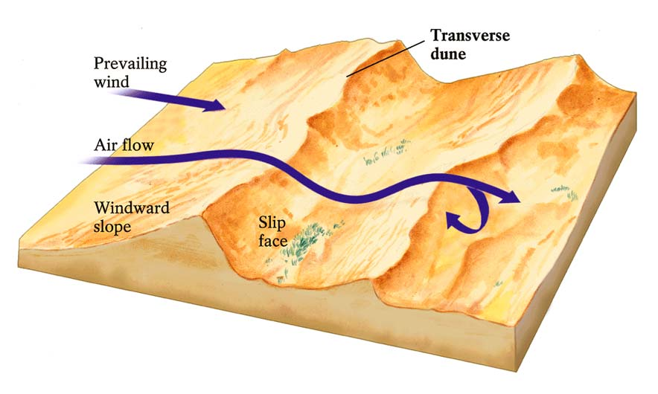
Transverse Dunes

Slide 84

Transverse Dunes

Slide 85

Longitudinal Dunes

Slide 86

Longitudinal Dunes

